Slide 1
Behind the LINQ
Diagnosing What EF Core Is Really Doing to Your Database
Chris Woody Woodruff
Senior Architect, Real Time Technologies

Slide 2
Story

Slide 3

Hello
Chris Woody Woodruff

Slide 4
I am not a dba!

Slide 5

We are not going to attack DBAs here!

Slide 6
What we want to solve?

Slide 7
Demo
Common Database Design Issues
BadBookStore represents a book store with a badly designed database schema.
8 queries that show what other developers (not smart Update Conference attendees) would do.

Slide 8
Goals for this talk!
Better use of the tools for SQL Server
Better use of Entity Framework Core for performance and happier users
Better relationship with your DBA’s!

Slide 9
Tip #1 – Have better databases

Slide 10
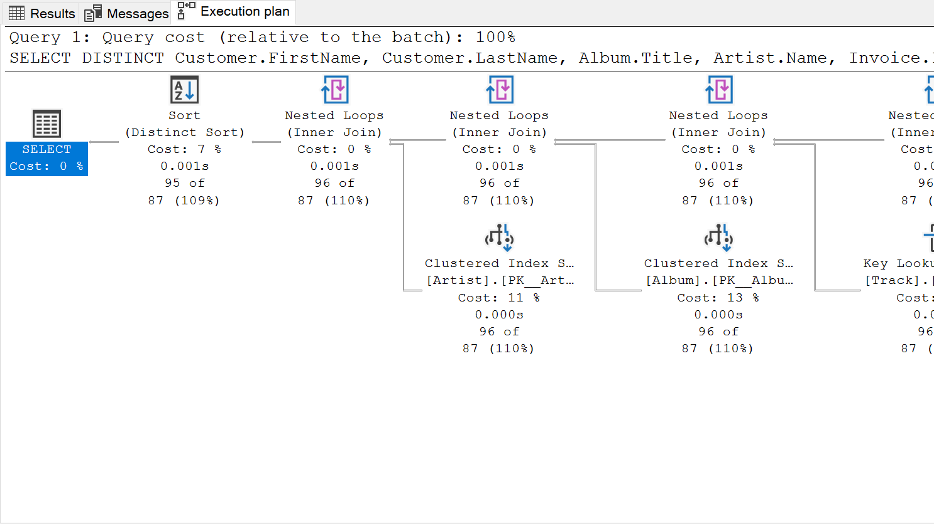
Tip #2 – understand query Plans

Slide 11
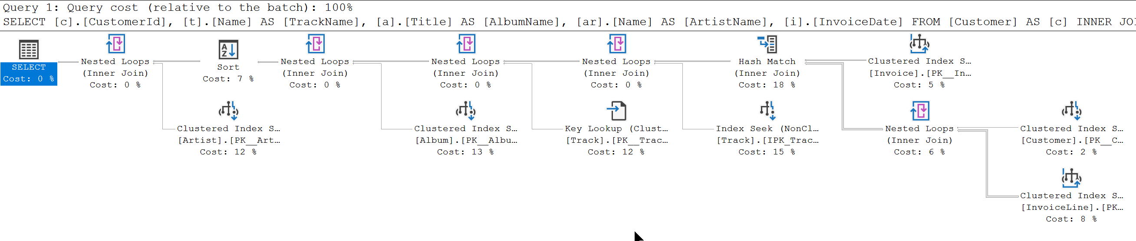
SELECT c.CustomerId, t.Name AS TrackName, a.Title AS AlbumName, ar.Name AS ArtistName, i.InvoiceDate
FROM Customer AS c
INNER JOIN Invoice AS i ON c.CustomerId = i.CustomerId
INNER JOIN InvoiceLine AS il ON i.InvoiceId = il.InvoiceId
INNER JOIN Track AS t ON il.TrackId = t.TrackId
INNER JOIN Album AS a ON t.AlbumId = a.AlbumId
INNER JOIN Artist AS ar ON a.ArtistId = ar.ArtistId
WHERE c.CustomerId = 2
ORDER BY AlbumName

Slide 12
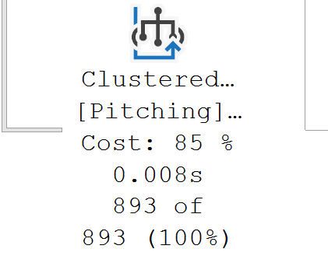
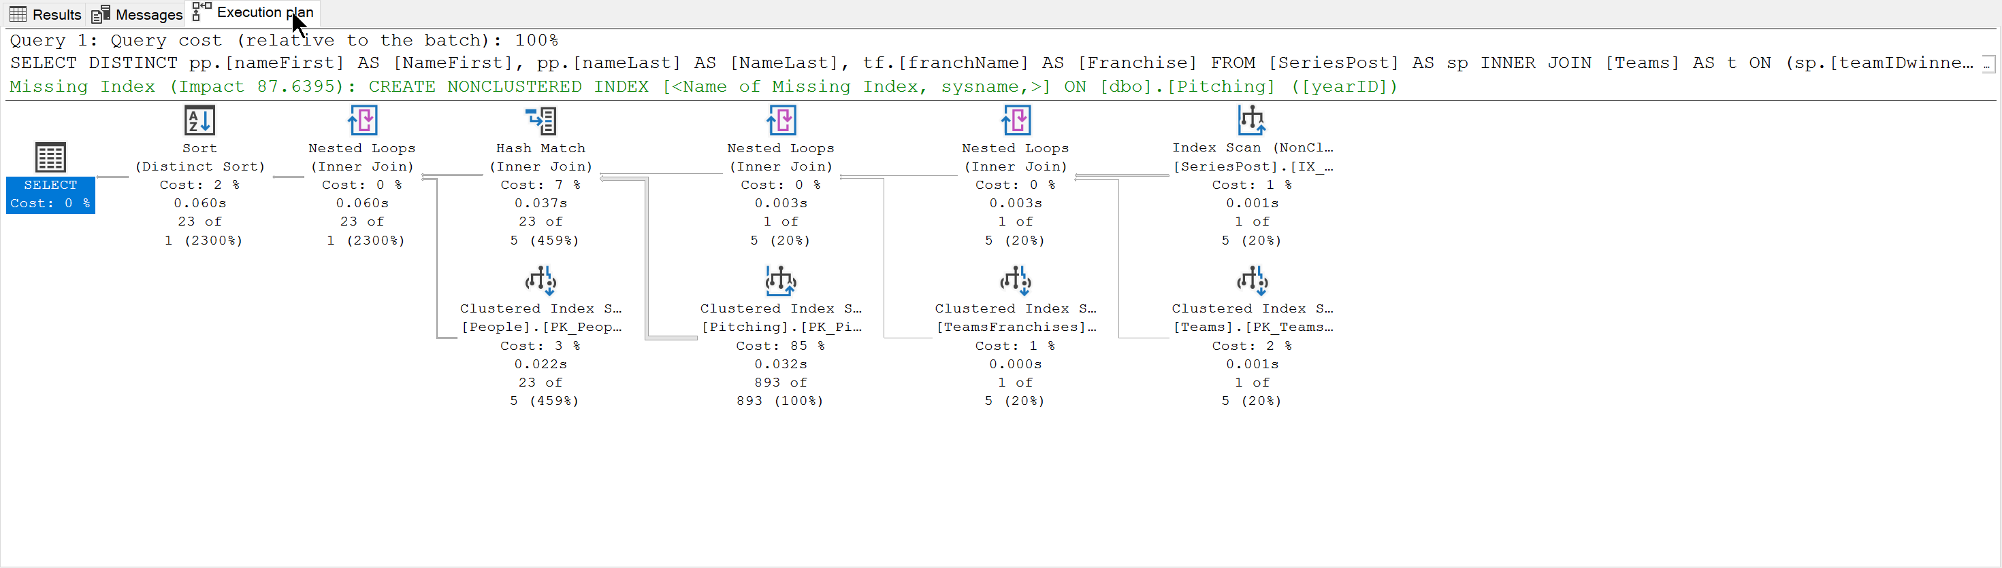
SELECT DISTINCT pp.[nameFirst] AS [NameFirst], pp.[nameLast] AS [NameLast], tf.[franchName] AS [Franchise]
FROM [SeriesPost] AS sp
INNER JOIN [Teams] AS t
ON (sp.[teamIDwinner] = t.[teamID]) AND (sp.[lgIDwinner] = t.[lgID]) AND (sp.[yearID] = t.[yearID])
INNER JOIN [TeamsFranchises] AS tf
ON t.[franchID] = tf.[franchID]
INNER JOIN [Pitching] AS p
ON (t.[teamID] = p.[teamID]) AND (t.[lgID] = p.[lgID]) AND (t.[yearID] = p.[yearID])
INNER JOIN [People] AS pp
ON p.[playerID] = pp.[playerID]
WHERE (sp.[round] = 'WS') AND (sp.[yearID] = 2018)

Slide 13

Tip #3 – Query Tags and Extended Events

Slide 14
Query Tags
var albums = _context.Album.Include(a => a.Artist)
.TagWith("Description: Query for Albums")
.TagWith("Query located: Chinook.Controllers.AlbumsController.Index() method")
.TagWith(@"Parameters:
None");

Slide 15
Query Tags
-- Description: Query for Albums
-- Query located: Chinook.Controllers.AlbumsController.Index() method
-- Parameters:
-- None
SELECT [a].[AlbumId], [a].[ArtistId],
[a].[Title], [a.Artist].[ArtistId], [a.Artist].[Name]
FROM [Album] AS [a]
INNER JOIN [Artist] AS [a.Artist] ON [a].[ArtistId] = [a.Artist].[ArtistId]

Slide 16
Extended Events
CREATE EVENT SESSION [ChinookAlbumQueries] ON SERVER
ADD EVENT sqlserver.sql_statement_completed(
ACTION(sqlserver.sql_text)
WHERE (
[sqlserver].[like_i_sql_unicode_string]
([sqlserver].[sql_text], N'%SELECT%ALBUM%'))
)
WITH (TRACK_CAUSALITY=ON);

Slide 17
Tip #4 – XXXX

Slide 18

Tip #5 – What we can do to improve our EF queries

Slide 19
String interpolation in raw SQL methods
var city = "Redmond";
using (var context = CreateContext())
{
context.Customers.FromSql($@“
SELECT *
FROM Customers
WHERE City = {city}");
}
var city = "Redmond";
using (var context = CreateContext())
{
FormattableString query =
$@“SELECT *
FROM Customers
WHERE City = {city}";
context.Customers.FromSql(query);
}
SELECT *
FROM Customers
WHERE City = @p0

Slide 20
Explicitly Compiled Queries
private static readonly Func<ChinookContext, AsyncEnumerable<Album>> _queryGetAllAlbums = EF.CompileAsyncQuery((ChinookContext db) => db.Album);
public async Task<List<Album>> GetAllAlbumsAsync() => await _queryGetAllAlbums(this).ToListAsync();

Slide 21
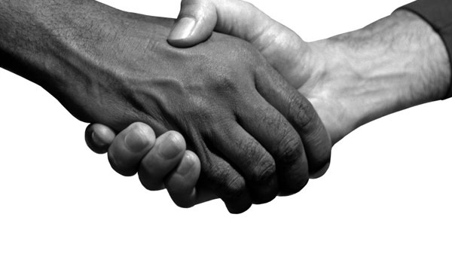
Be nice to your DBA!

Slide 22
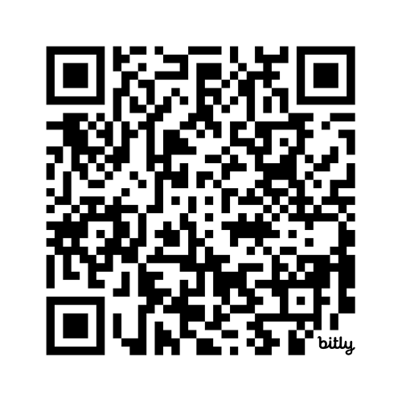
Wrap Up!
github.com/cwoodruff/EFCorePerfDemos

Slide 23
Thank You!!!
@woodruff.dev
chris.woodruff
cwoodruff

